Slide 1
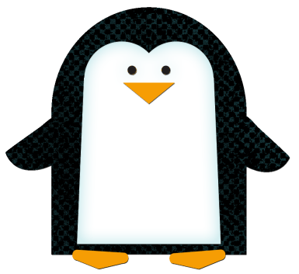
After reading Penguin Chick, complete the double bubble below comparing and contrasting penguin chicks to human children. Replace the bubbles below with appropriate pictures if possible. You can copy and paste the bubbles if you add text to your double bubble map. Then, delete these directions.
Penguin Chicks
Children

