Slide 1

Finding Context Clues
Practicing with Artful Thinking and Artwork

Slide 2
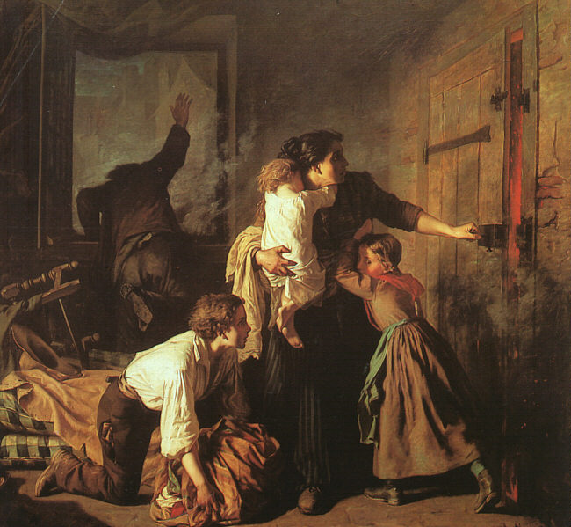
What’s going on in this picture?
What makes you say that?
BEGINNING
MIDDLE or
END
Is this painting the
Beginning
Middle
or
Ending of the story?
PERCEIVE What can the person or thing perceive? Step inside the role of the person or thing. |  | KNOW What might the person or thing know about or believe? |  | CARE ABOUT What might the person or thing care about?

Slide 3
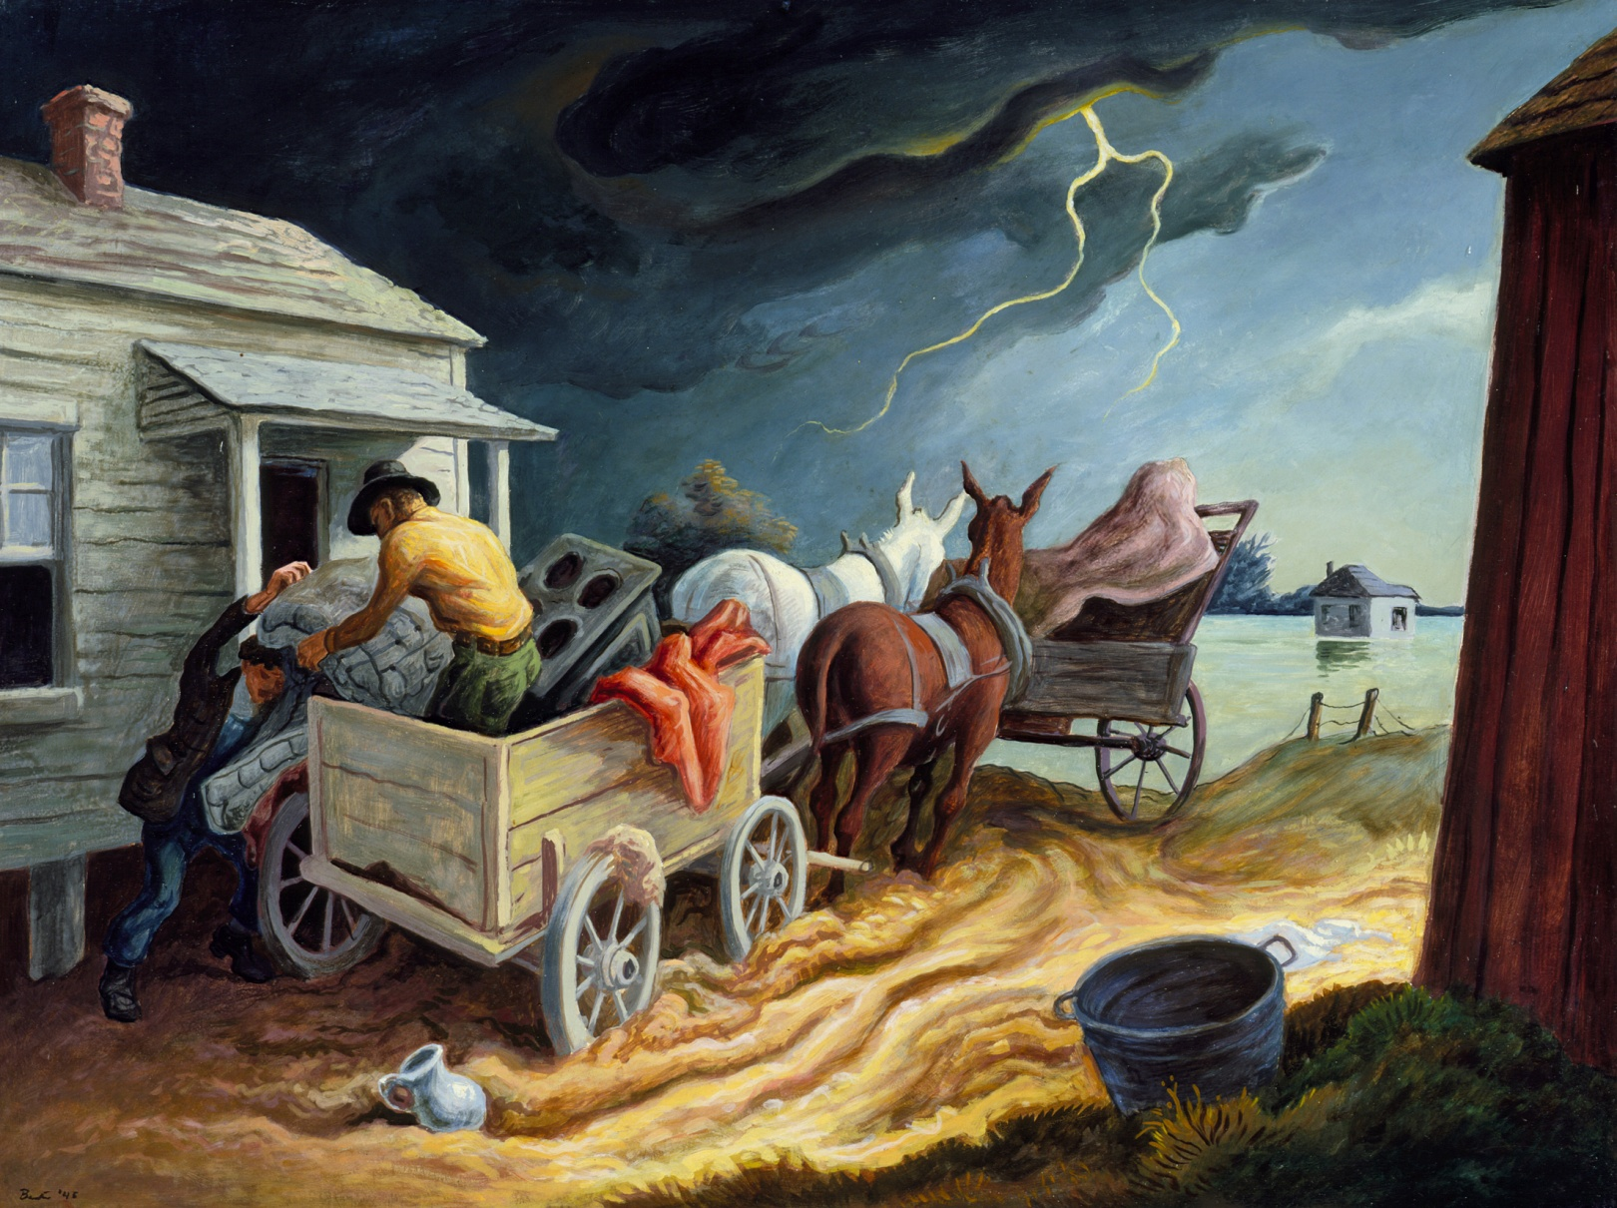
Notes:
Thomas Hart Benton Spring on the Missouri 1945

Slide 4
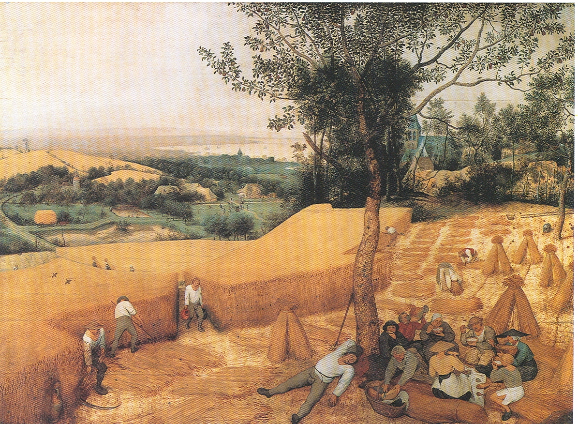
Notes:
Brueghel, Peter the Elder: The Harvesters

Slide 5
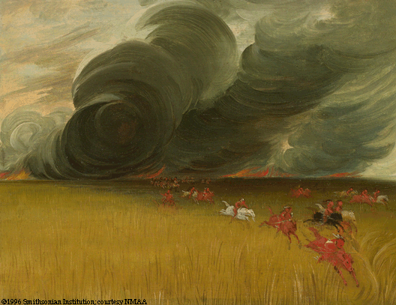
Notes:
Caitlin, George: Prairie Meadows Burning, 1832

Slide 6
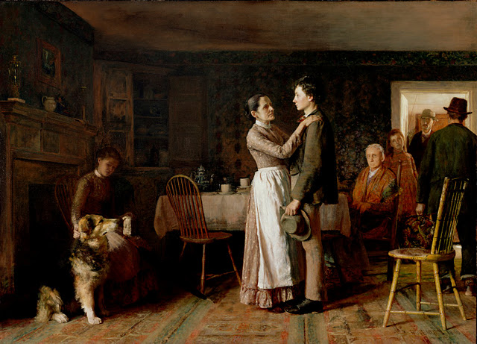
Breaking Home Ties
Thomas Hoveden, 1890

Slide 7
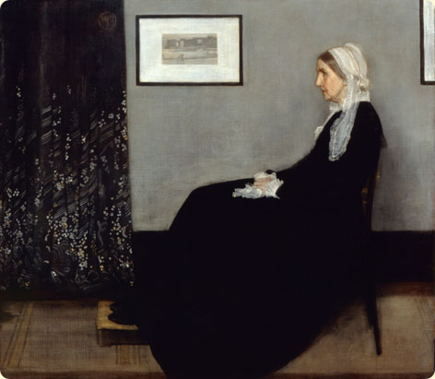
Notes:
James McNeill Whistler, Arrangement in Grey and Black, No. 1:, 1871, oil on canvas. Musée d'Orsay, Paris.

Slide 8
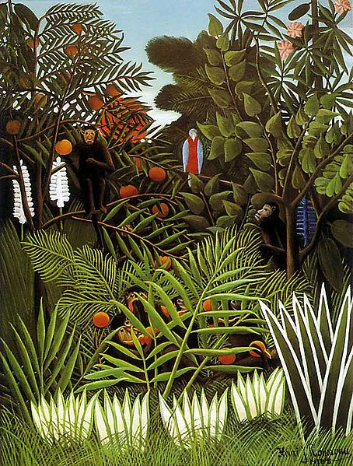
Notes:
Henry Rouseau

Slide 9
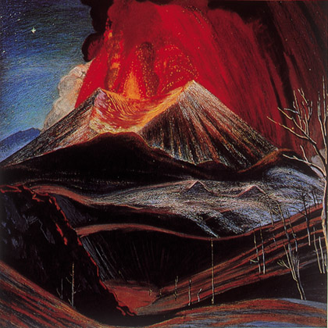
Notes:
Eruption of Paracutín Dr. Atl (Mexico) 1943

Slide 10
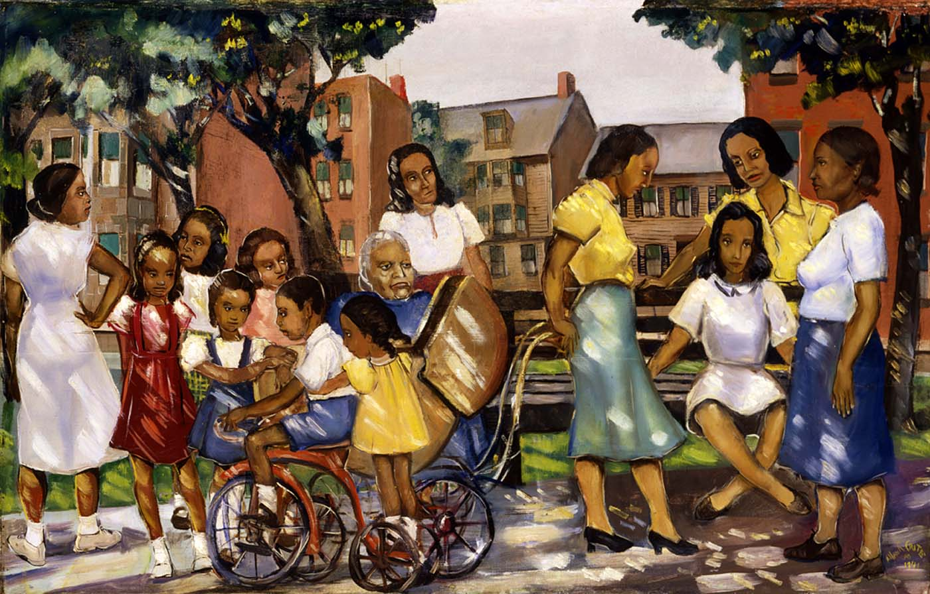
Examine this artwork by American artist, Alan Crite….
If you were him, what would you title this painting? Think of a title that would capture the ideas (context clues) you see in the painting .
How does your title compare to the Artist’s title?
Notes:
Crite, Alan Sunlight and Shadows

Slide 11
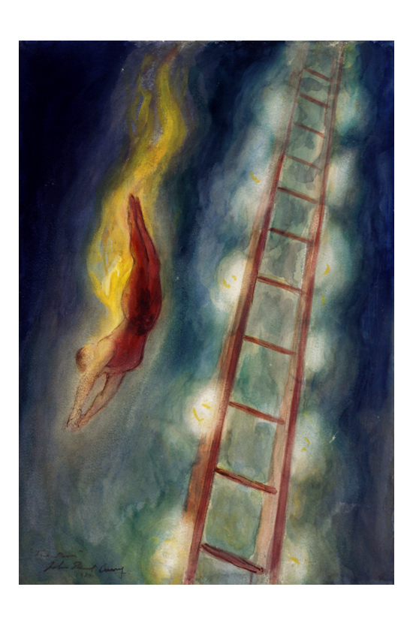
Notes:
Curry The Fire Diver 1934

Slide 12
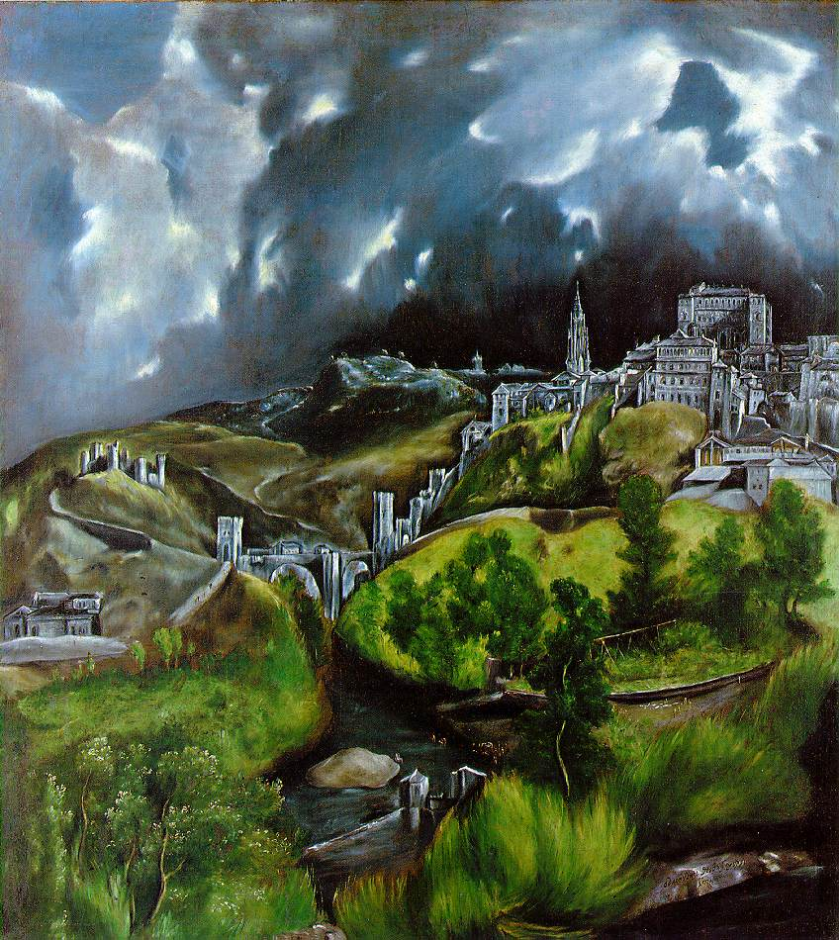
Notes:
El Greco_View of Toledo_1547

Slide 13
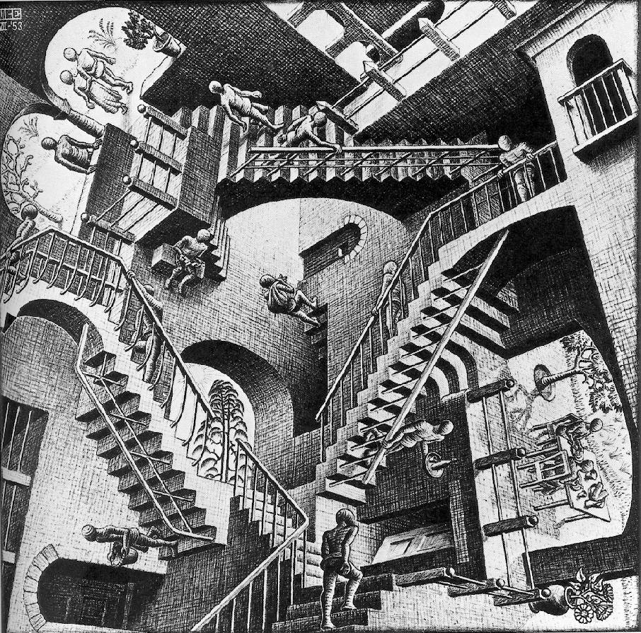
Notes:
MC Escher Relativity 1953

Slide 14
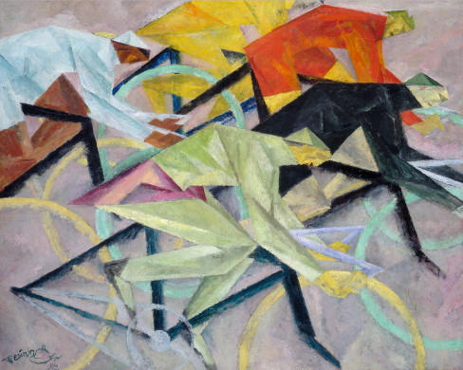
Notes:
Feininger, L The Bicycle Race 1912

Slide 15
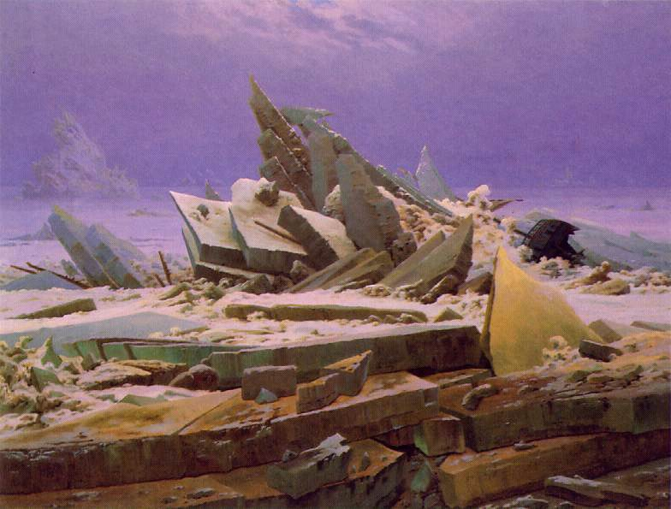
Notes:
Freidrich, Casper Sea of Ice

