Slide 1
Cause & Effect
Artful Thinking Routines for Exploring Cause and Effect
Beginning, Middle or End?
What Makes You Say That?
Claim, Support, Question
Notes:
Students identify whether the image is a cause or an effect – what happened/will happen (Use Beginning, Middle or End)
Students determine what caused the scene WMYST? CSQ.
Students determine what is the effect of what is going on in the scene

Slide 2
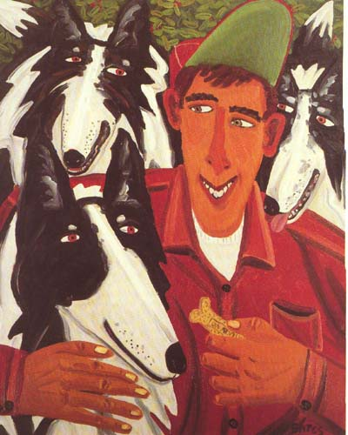
Notes:
Bates: Milkbone

Slide 3
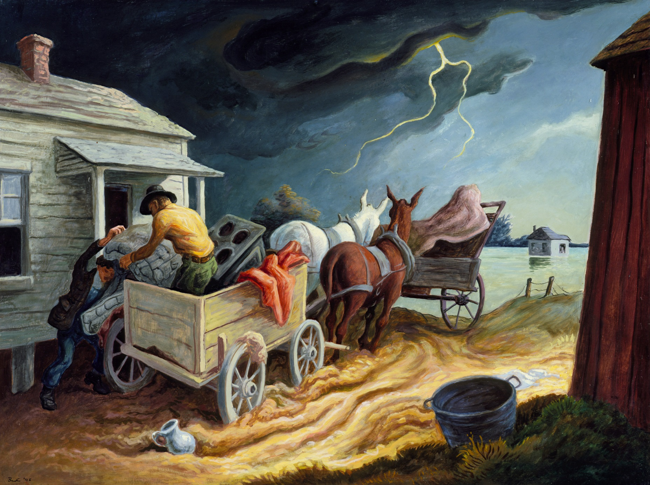
Notes:
Benton: Spring on the Missouri

Slide 4
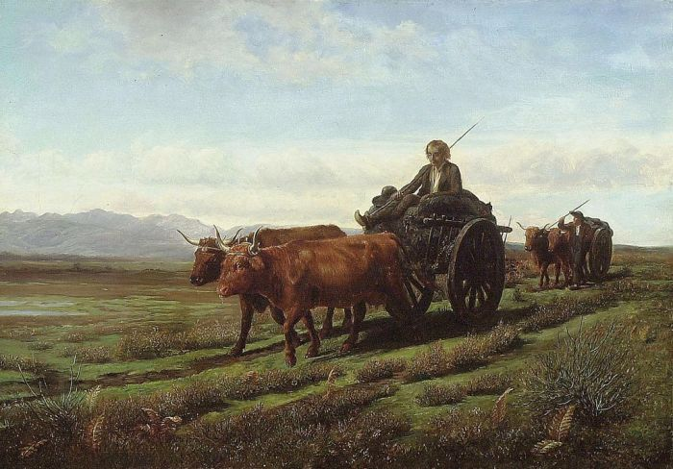
Notes:
Bonheur: Going to Market

Slide 5
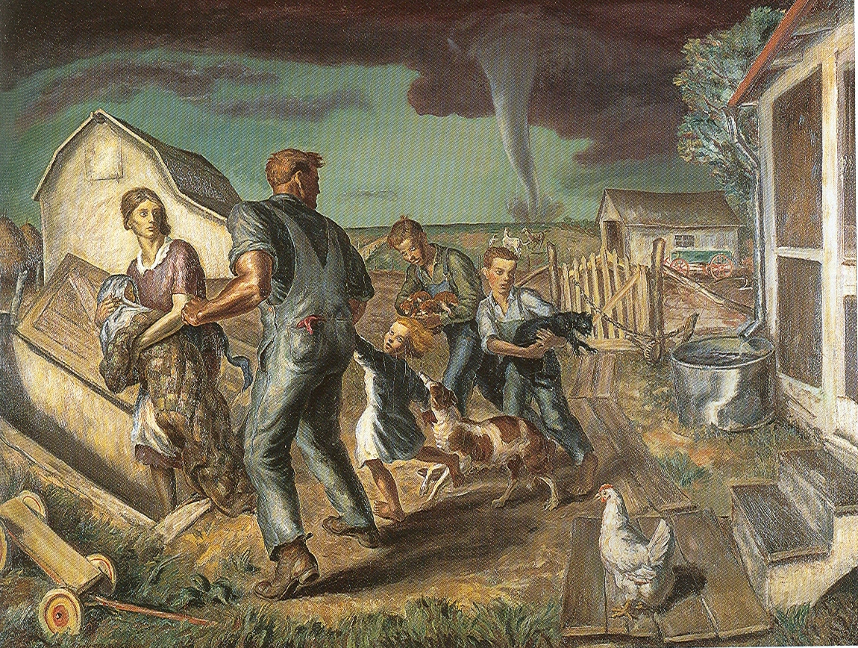
Notes:
Curry: Tornado over Kansas

Slide 6
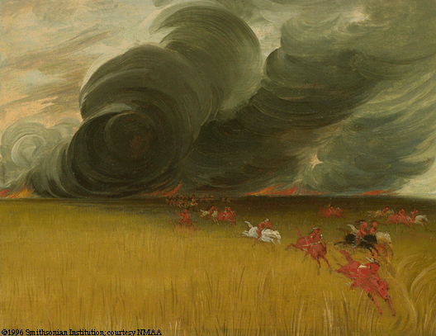
Notes:
Catlin: Prairie Meadows on Fire

Slide 7
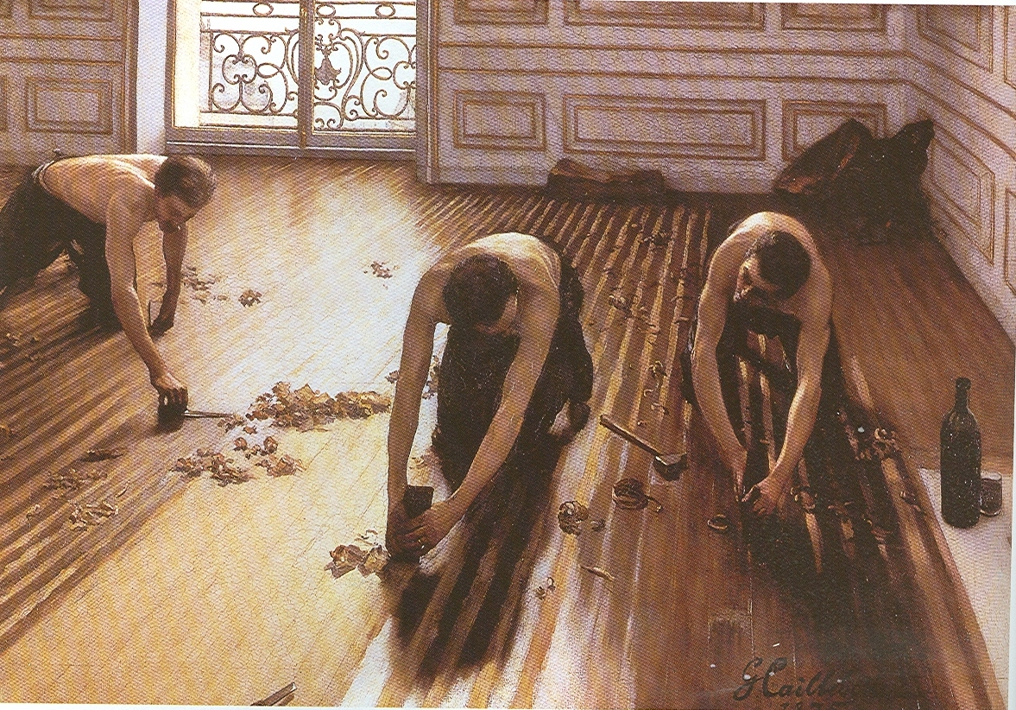
Notes:
Calliabotte: The Floor Scrapers

Slide 8
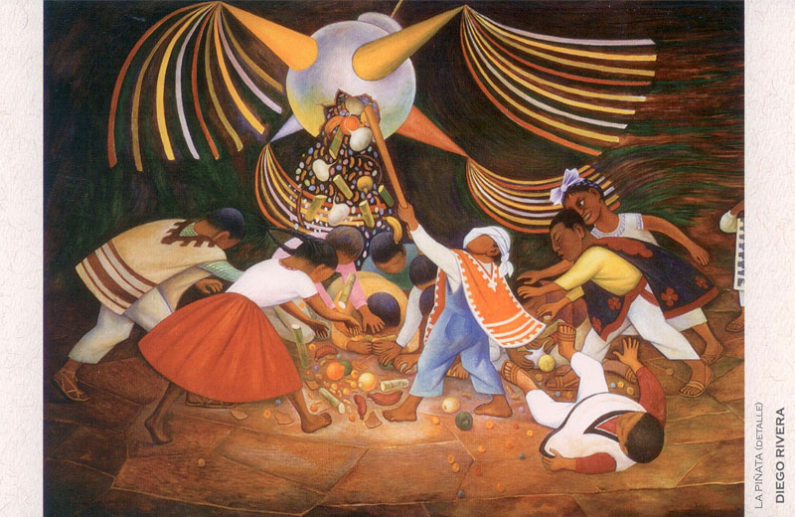
Notes:
Diego Rivera: La Pinata

Slide 9
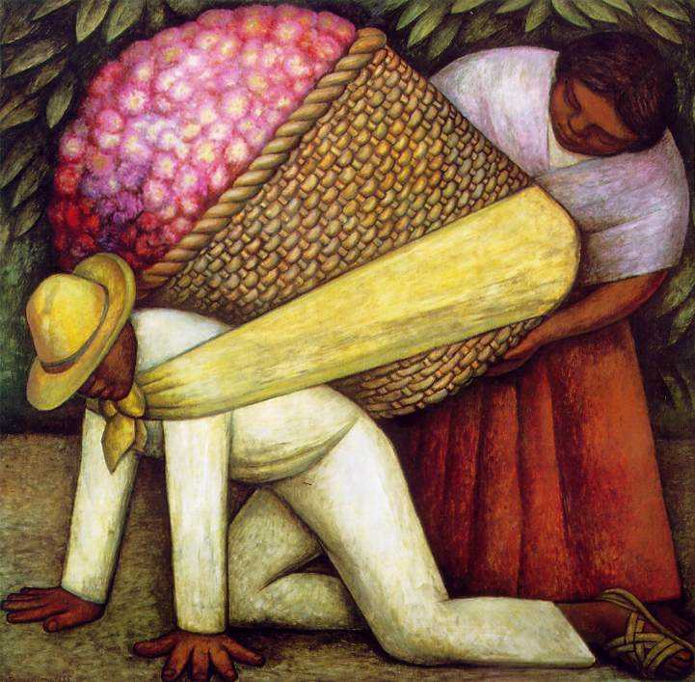
Notes:
Riviera: Flower Carrier

Slide 10
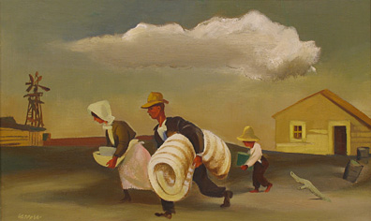
Notes:
Gropper, Migration

Slide 11
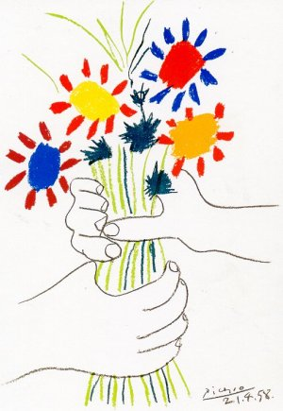
Notes:
Picasso: Untitled 1962

Slide 12
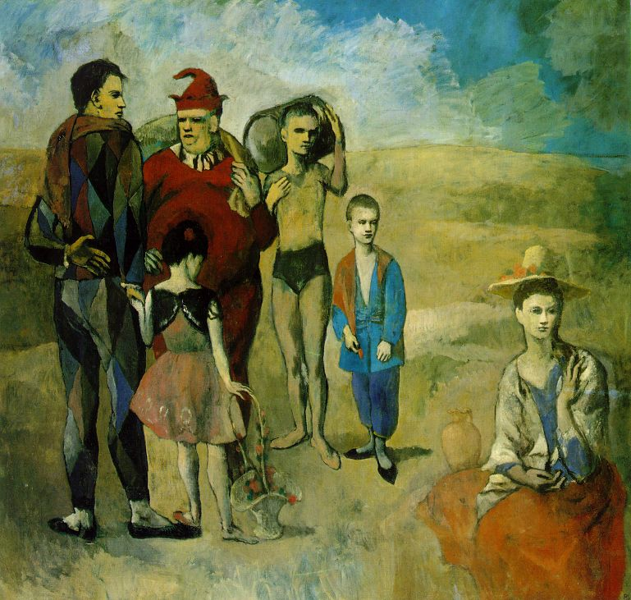
Notes:
Picasso: The Acrobats

Slide 13
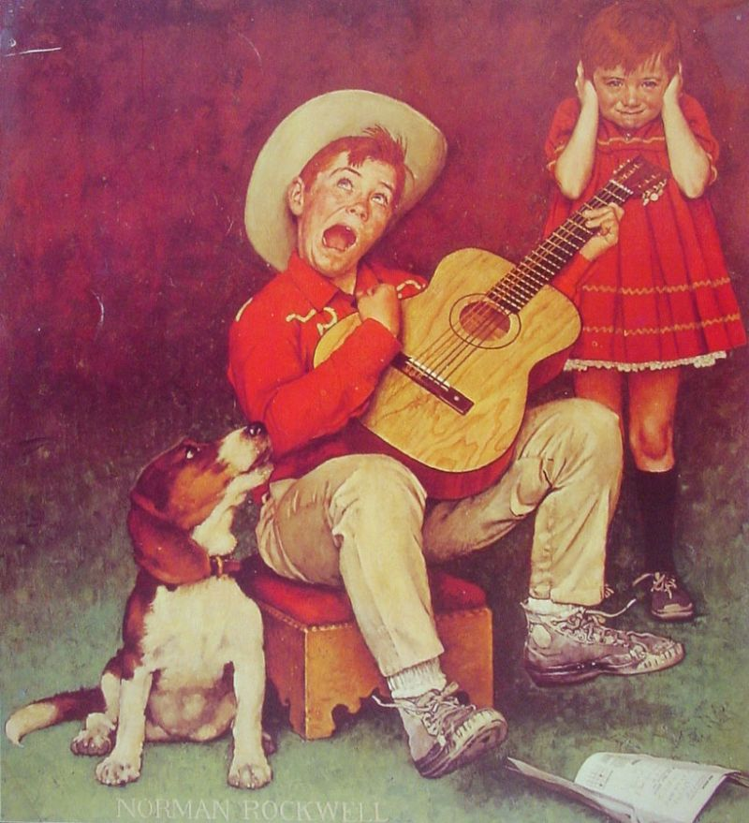
Notes:
Rockwell- The Music Man

Slide 14
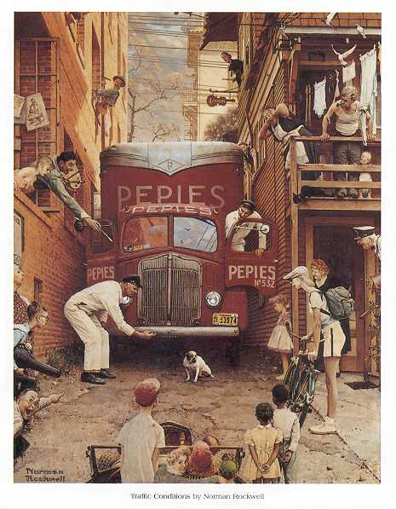
Notes:
Rockwell: Traffic Conditions

Slide 15
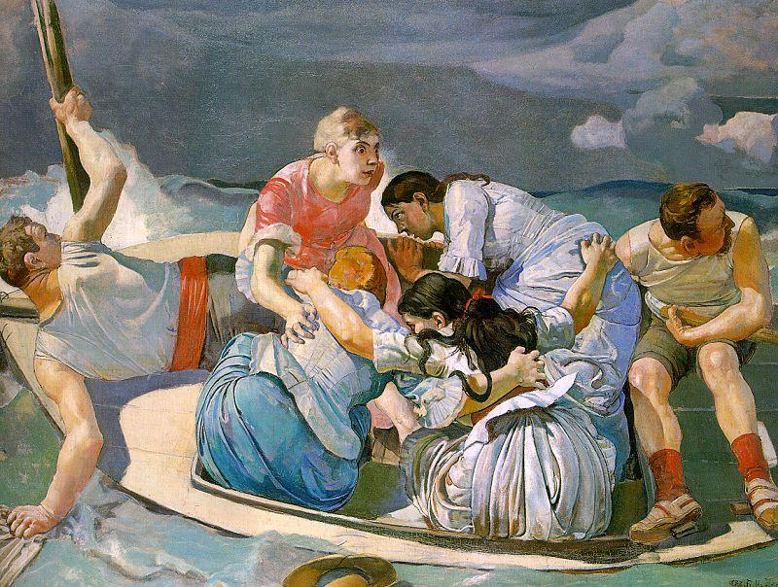
Notes:
Hodler: Surprised by the Storm

Slide 16
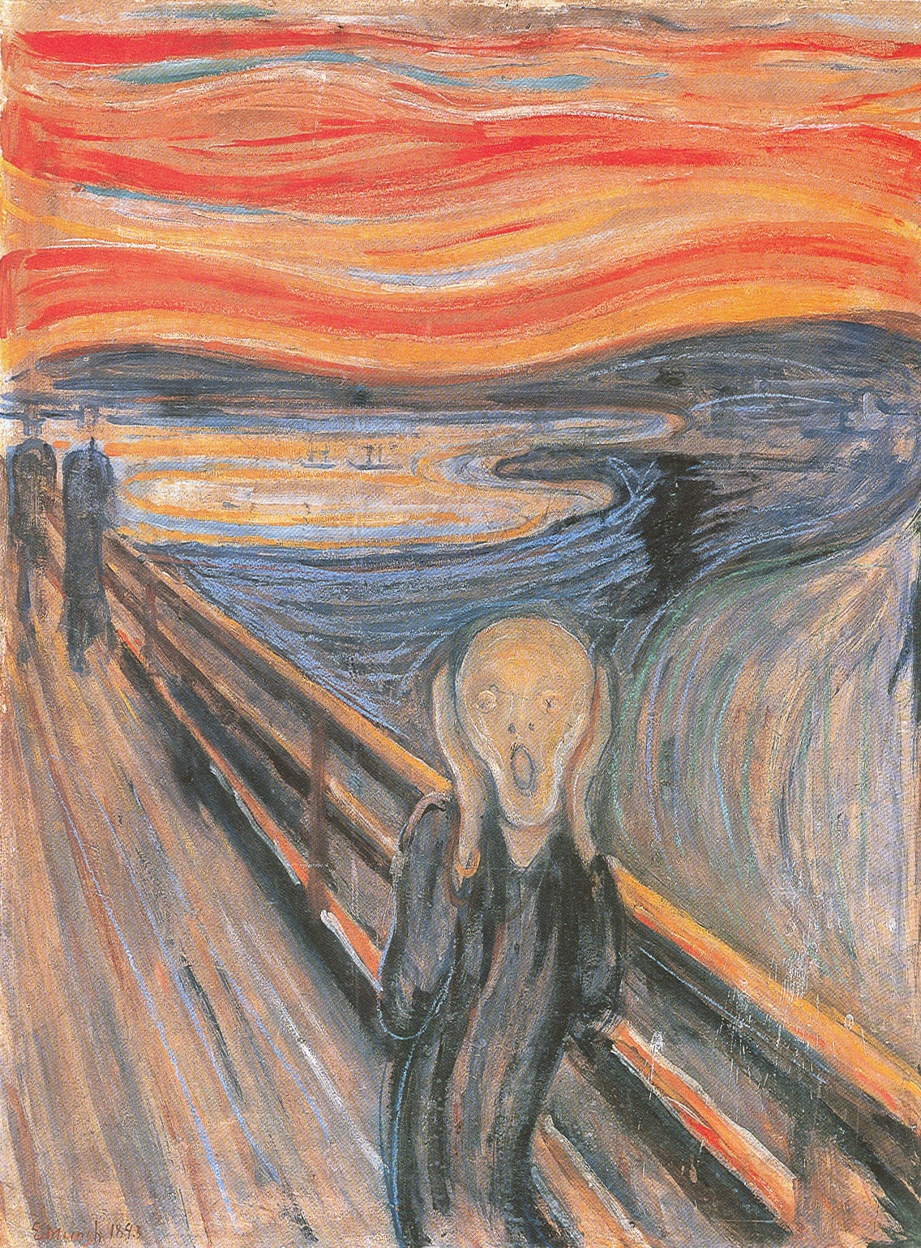
Notes:
Edvard Munch: The Scream

Slide 17
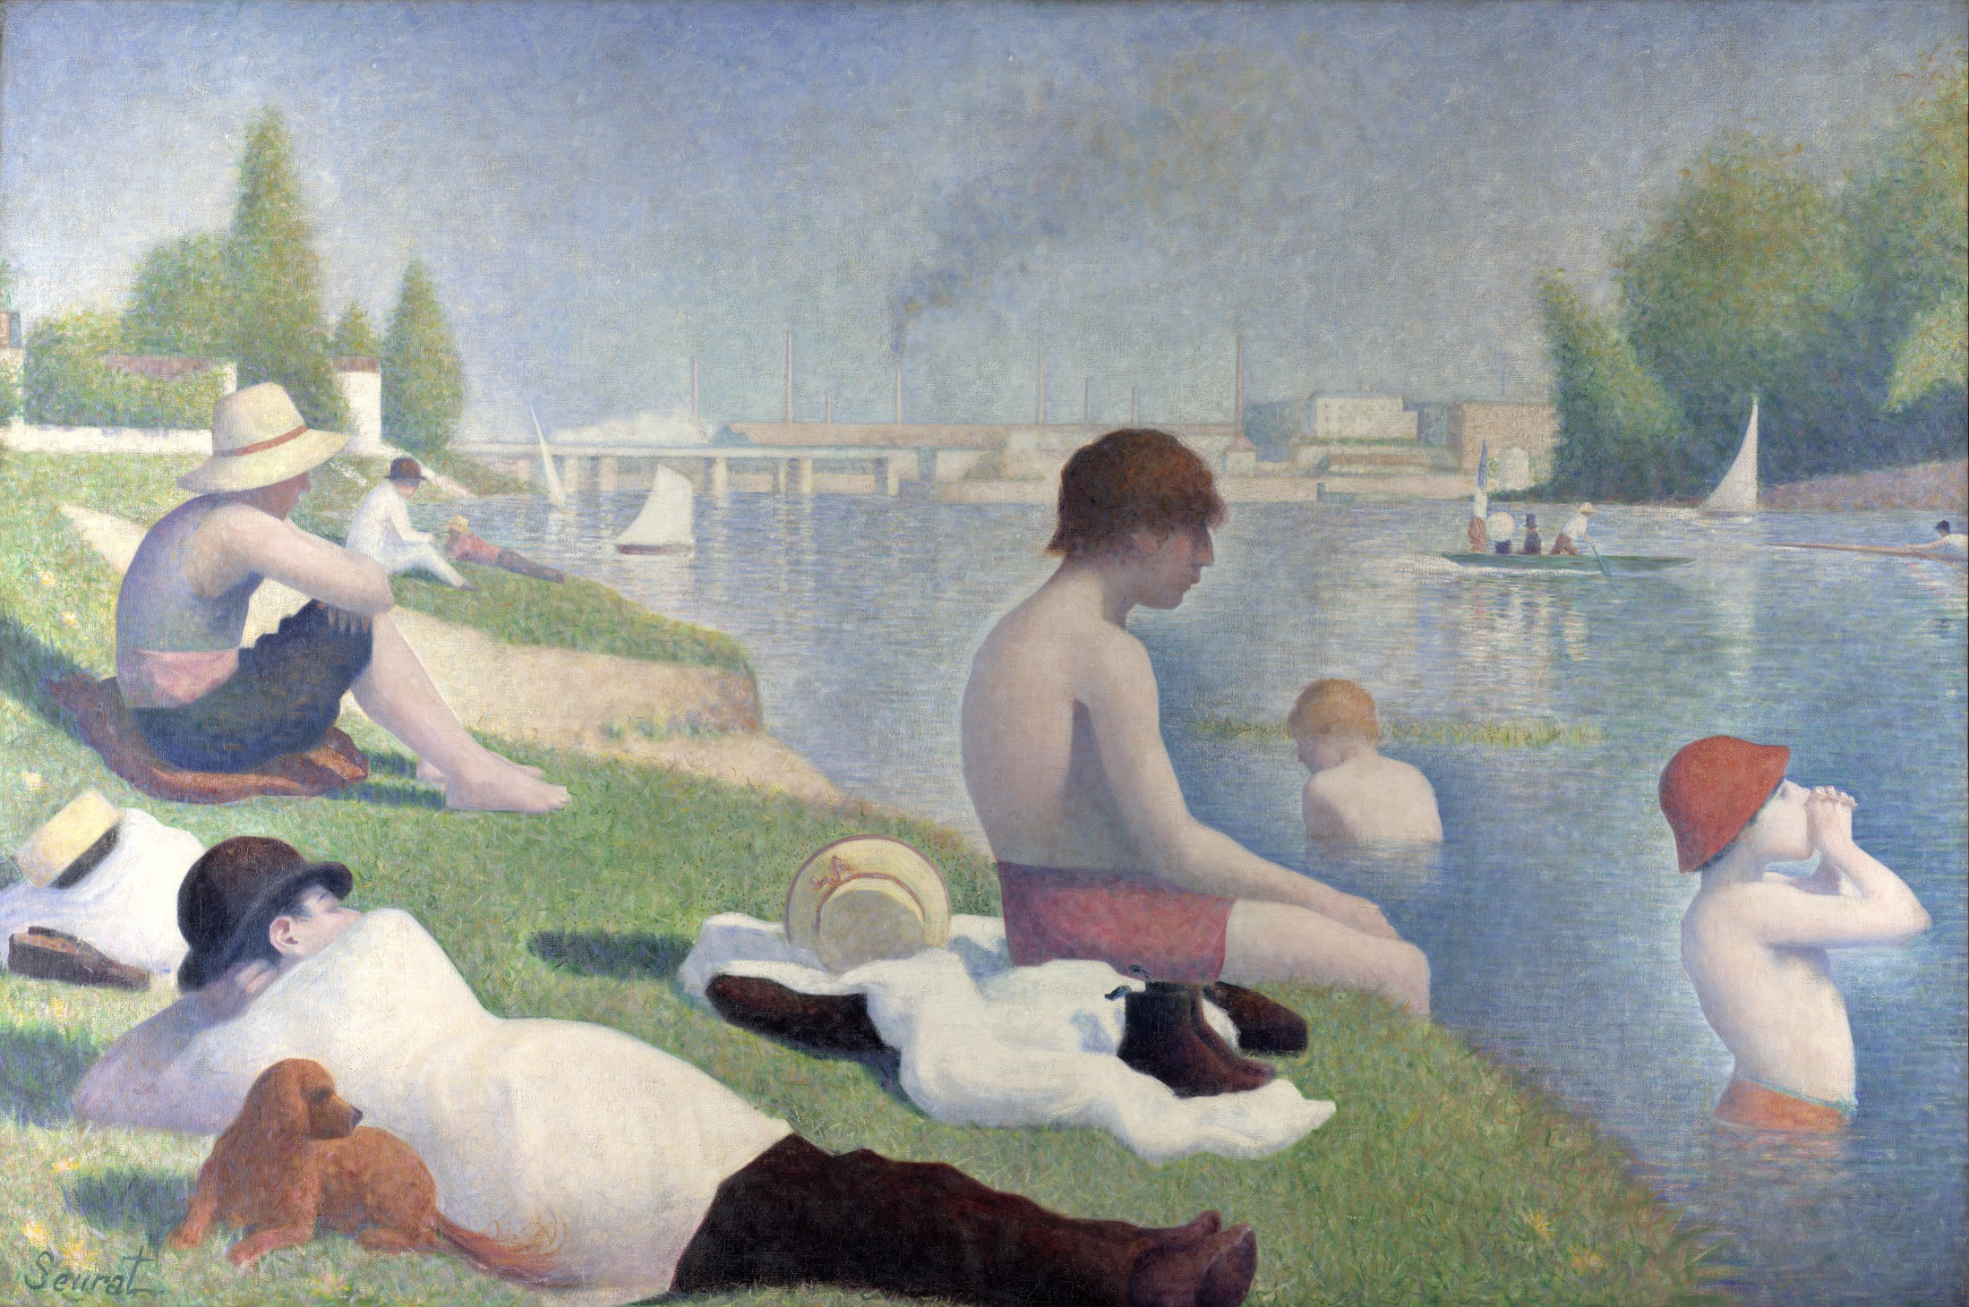
Notes:
Seuratt: Bathers

Slide 18
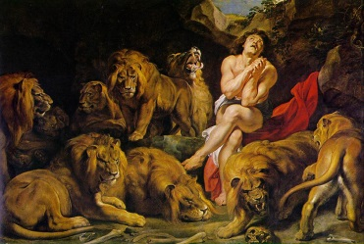
Notes:
Rubens: Daniel in the Lion Den

Slide 19
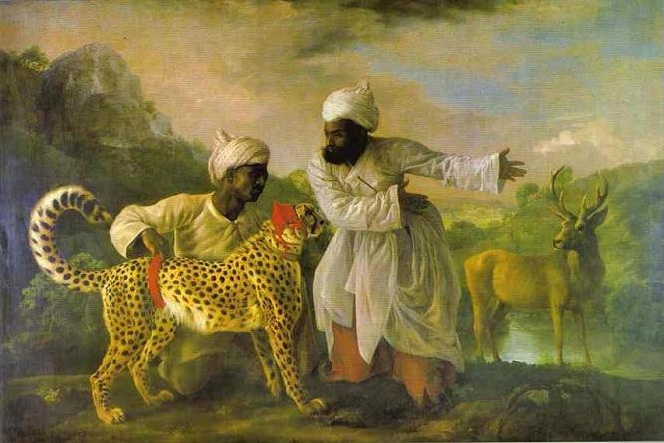
Notes:
Stubbs: Cheetah with Two Indian Attendants

