Slide 1
The mysteries of Harris Burdick
- Drawing Conclusions -
- Writing Extensions -

Slide 2
Directions:
1) Scan the QR code on each page.
2) Draw conclusions about what is occurring in each of these photos
3) Options of presentation:
Write thoughts on poster paper around picture your teacher has hung up on the walls.
Save this PPT as “FirstNameLastInitial_QRHBurdick” and write directly on the QR Page
Create a Word Document (in Office365/OneDrive or Google Drive) that records your final writing project of finishing the mystery story in the images.
4) Differentiation – Have students choose any # of QR codes to reflect upon or have them do specific images. Have students work with teams based on the picture they’re interested in.

Slide 3
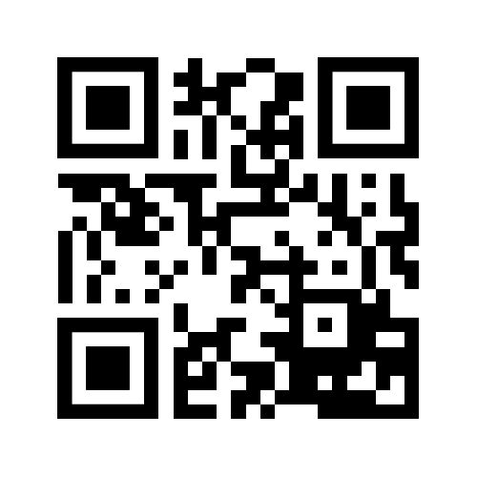

Slide 4
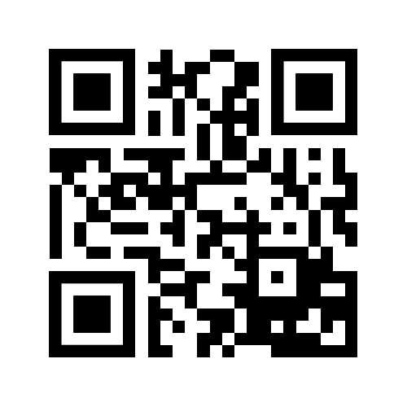

Slide 5
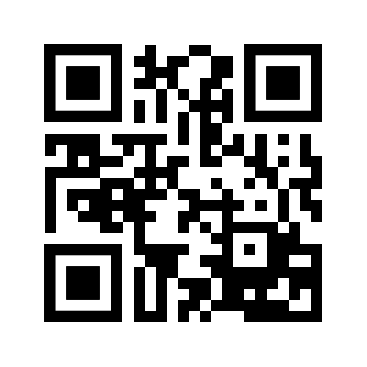

Slide 6
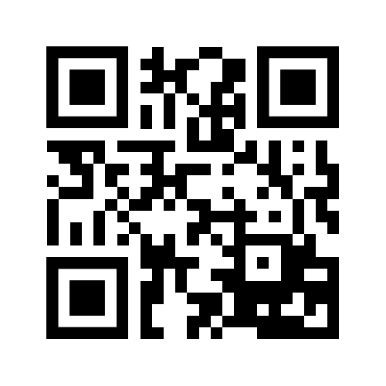
Scan the QR Code below to access all pictures from The Mysteries of Harris Burdick.

