Slide 1
Determine the Moral of the Story and then the Theme!
Scan one of the QR codes to read a story.
After reading, consider the Moral of the Story and then the Theme of the story in the pages following.

Slide 2
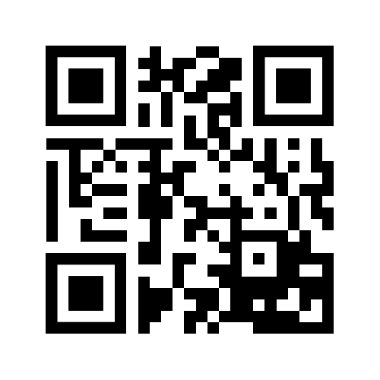
Tyrone The Horrible

Slide 3
Respond to Tyronne the Horrible Here!!
What is the Theme?
What is the Moral of Story?

Slide 4
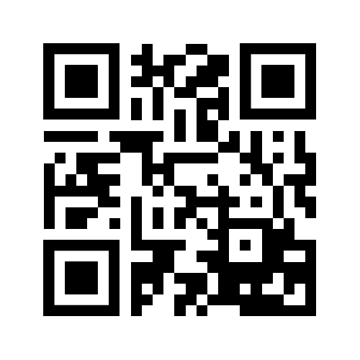
The Royal Raven

Slide 5
Respond to The Royal Raven Here!!
What is the Theme?
What is the Moral of Story?

